Slide 1
C++ in Summary

Slide 2
1. C++ Compiler
Compiler
  Converting high-level language code to machine language code
C++ compiler generates executable file (binary code) from C++ source code (files).
Visual Studio 20xx
  Installed in our PC rooms (Building 208 4th, 5th, 6th floors)
g++ (LINUX, macOS, MS Windows, cygwin, …)
  > g++ -o TestProg TestProg.cpp
  ./TestProg
C++ program
int main…
Compiler
Machine
language
010101…

Slide 3
2. Useful Youtube Tutorials for C++ Beginner
Compile C++ with Visual Studio 2017
https://youtu.be/2Oi0jynRy9E
C++ Tutorial for Beginners – Full Course
https://youtu.be/vLnPwxZdW4Y
Using Makefile for compiling multiple C++ source files
https://youtu.be/aw9wHbFTnAQ

Slide 4
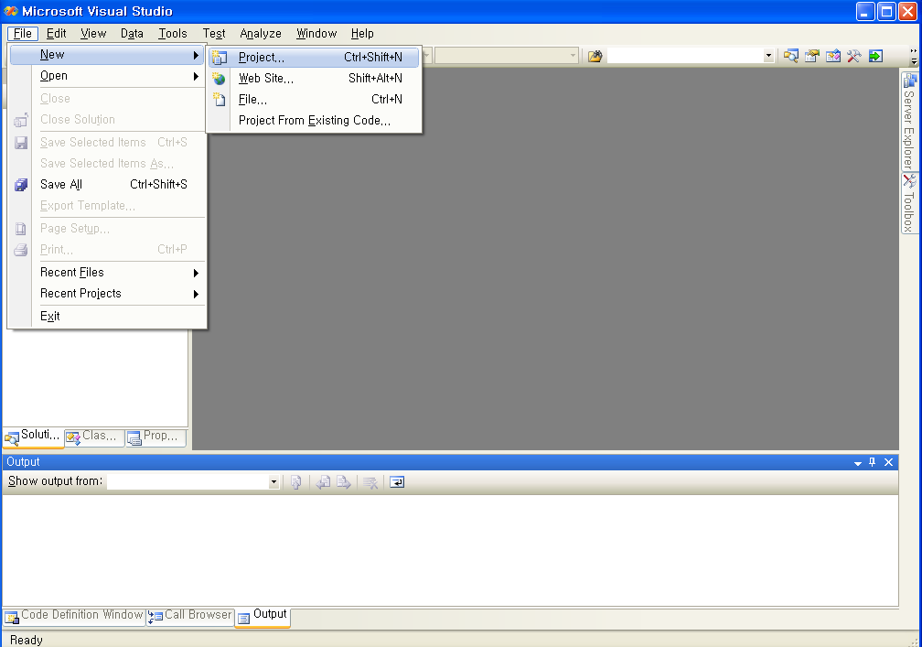
Visual Studio 2008 :
Creating Command-Line Program

Slide 5
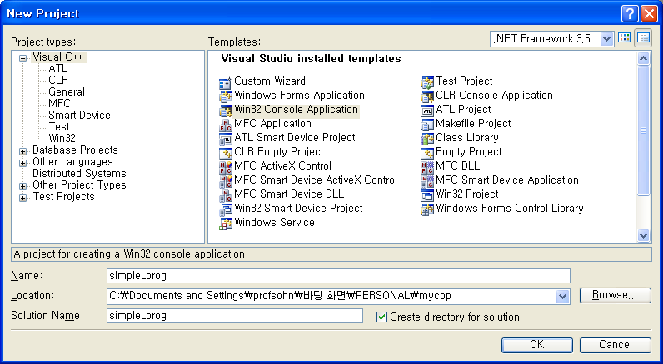
Visual Studio 2008
Creating Command-Line Program

Slide 6
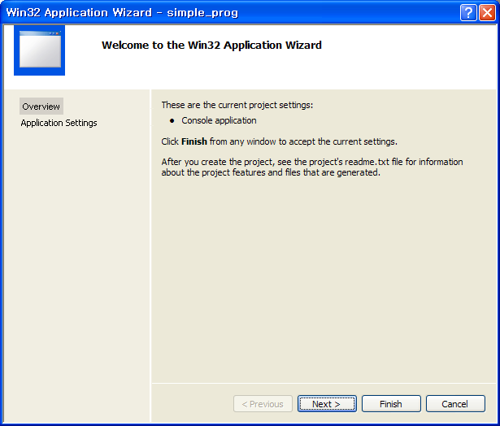
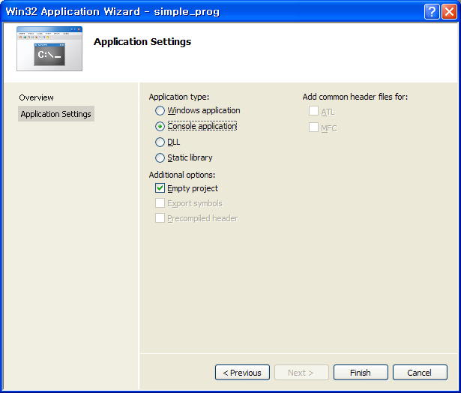
Visual Studio 2008
Creating Command-Line Program

Slide 7
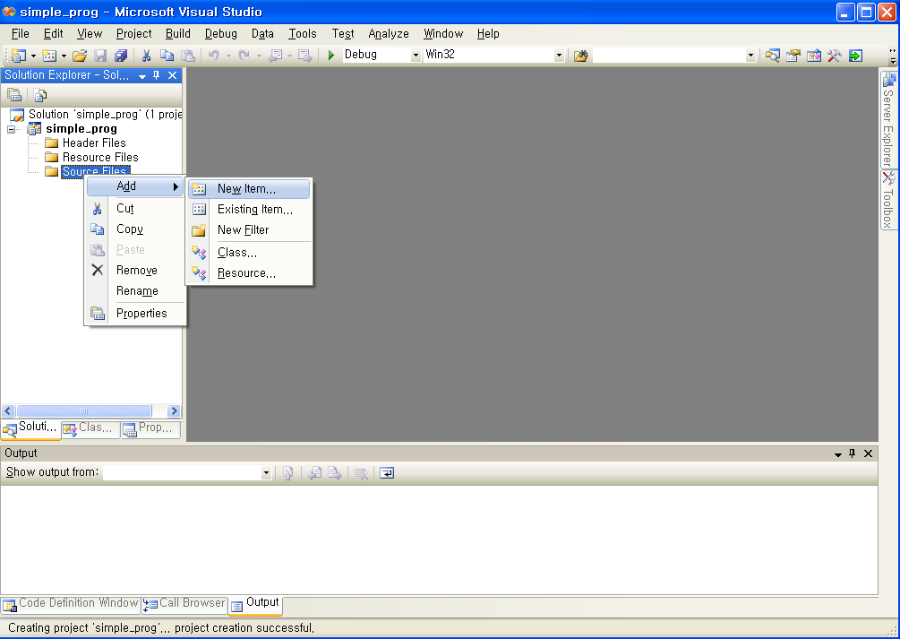
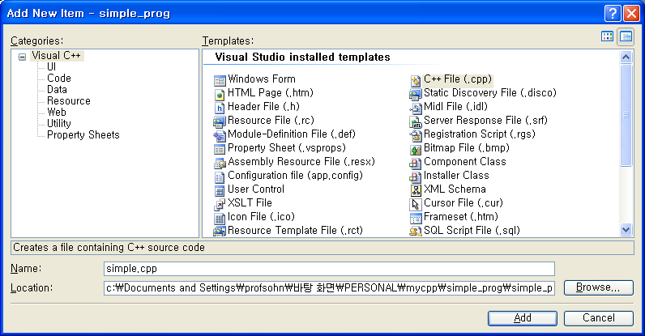
Visual Studio 2008
Creating Command-Line Program

Slide 8
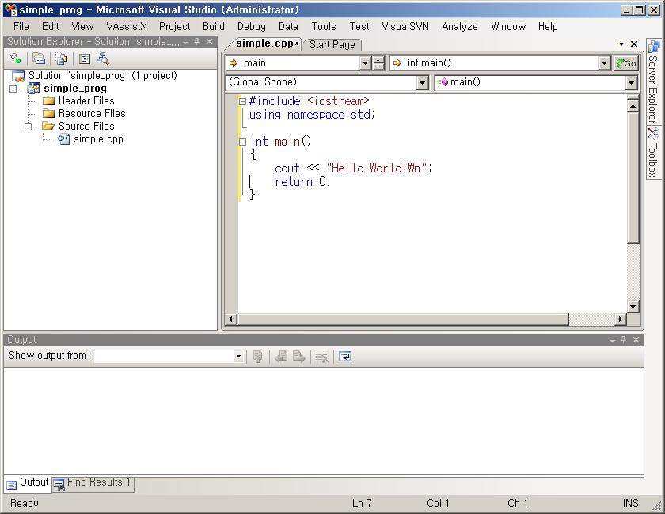
Visual Studio 2008
Creating Command-Line Program
Build (compile)
&
execute

Slide 9
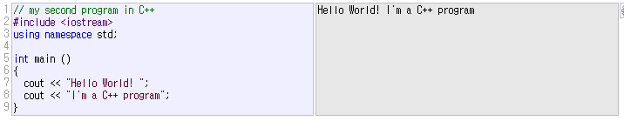
3. “Hello World!” code
header file
It is OK to use C code in C++ program

Slide 10



4. Standard Input/Output
cout : screen stream object
  (standard output)
comments

Slide 11

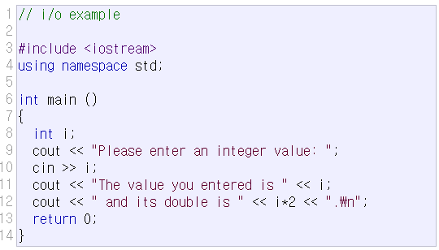

4. Standard Input/Output
cin : keyboard stream object
(standard input)

Slide 12
Formatting
formatting similar to printf
std::format (C++20)
std::print (C++23)
// src_print.cpp
#include <iostream>
#include <cstdio>
#include <print>
#include <format>
using namespace std;
int main()
{
double pi=3.141592;
int age = 21;
printf("pi=%7.2f , age=%d\n",pi,age);
cout << format("pi={:7.2f} , age={}\n",pi,age);
print("pi={:7.2f} , age={}\n",pi,age);
return 0;
}
[program output]
pi= 3.14 , age=21
pi= 3.14 , age=21
pi= 3.14 , age=21

Slide 13
5. Variables and Data Types
Variable
  Named memory location where data value is stored
  Each variable has a certain type
  Variables must be declared before use in a program
char (1 byte) : capable of holding one character (ascii code)
int (4 bytes) : integer
float (4 bytes) : single-precision floating point
double (8 bytes) : double-precision floating point
type | size | min value | max value
char | 1byte | -2⁷ = -128 | 2⁷-1 = 127
short | 2byte | -2¹⁵ = -32,768 | 2¹⁵-1 = 32,767
int | 4byte | -2³¹ = -2,147,483,648 | 2³¹-1 = 2,147,483,647
min/max values are defined in <limits> header file
use unsigned type when representing only positive numbers
  unsigned char , unsigned short, unsigned int

Slide 14
6. string type
standard type for storing and manipulating text
(a class provided by the C++ standard library)
Unlike C-style strings (char *),
string automatically manages memory and
provides many convenient functions
getline(cin,str) function is used to read a line of text.
Example code
  src_string.cpp
  src_getline.cpp

Slide 15
7 : Control Structures if, loop (while, for)

Slide 16
Conditional Statement: if
block : enclosed by { }
if , if-else , if – else if - else
Example
  if ( num1 >= num2 )
  {
  printf(“num1 is greater than num2\n“);
  printf(“The difference is: %d\n”, num1- num2);
  } else {
  printf(“num2 is greater than or equal to num1\n”;
  printf(“The difference is: %d\n”, num2 – num1);
  }

Slide 17
while - loop
num = 1;
Sum = 0;
true
sum = sum + num;
num = num + 1;
num <= 10
num = 1;
sum = 0;
while (num <= 10) {
sum = sum + num;
num = num + 1;
}
false

Slide 18
for - loop
Repetition
  control variable initialization
  Test Conditon
  Modification of control variable value
order : (1) (2) body (3) (2) body (3) (2) body … body (3) (2)
* Example
sum=0;
for(int num = 1; num <= 10; num++ ) {
sum += num;
num++;
}
for ( (1); (2); (3) )
{
(body)
}
(1)
(2)
FALSE
TRUE
body
(3)

Slide 19
break & continue
break in loop
  go out of the loop block and execute next to the loop
  Example
  while (1) {
  cin >> j;
  if (j == 0)
  break;
  result = i/j;
  }
continue in loop
  go to condition-test and next iteration of the loop
  Example
  sum = 0;
  for (i = 0; i <= n; i++) {
  if (i % 2 == 0)
  continue;
  sum += i;
  }

Slide 20
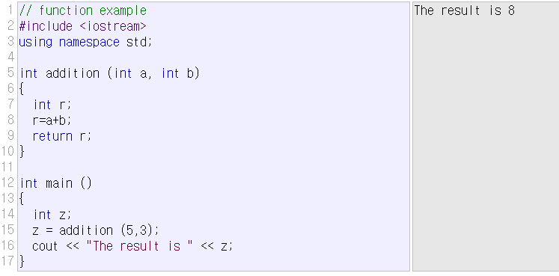
8. Functions
local variables vs global variables
local variables (including parameter variables)
  created when function is called
  deleted when function returns

Slide 21
why use functions?
many reasons
– Don’t have to repeat the same block of code many times. Make that code block a function and call it when needed.
– Reuse : useful functions can be reused in a number of programs.
– top-down technique : Make an outline and hierarchy of the steps needed to solve your problem and create a function for each step.
– Easy to debug : Get one function working well then move on to the others.
– Easy to modify and expand : Just add more functions to extend program capability
– Readabilty : Make program self-documenting and readable.

Slide 22
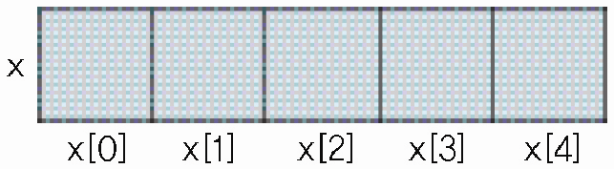
9. array
a fixed-sized collection of elements of the same type
stored consecutively in memory
fast random access (ex) x[15]=3;
string as an array of characters (ex) src_string_cstyle.c
int main()
{
int x0, x1, x2, x3, x4;
cout << "Get 5 integers : ";
cin >> x0;
cin >> x1;
cin >> x2;
cin >> x3;
cin >> x4;
cout << "Reverse Order : ";
cout << x4 << " ";
cout << x3 << " ";
cout << x2 << " ";
cout << x1 << " ";
cout << x0 << ”\n";
return 0;
}
int main()
{
int x[5], i;
cout << "Get 5 integers : ";
for (i = 0; i < 5; ++i)
cin >> x[i];
cout << "Reverse order : ";
for (i = 4; i >= 0; --i)
cout << x[i] << " " ;
cout << "\n";
return 0;
}

Slide 23
10. pointer
pointer type variable
  “pointer” usually means memory address
  a variable that stores memory address
  size is always: 8 bytes (in 64-bit systems), 4 bytes (in 32-bit systems)
Remember
  *
    multiplication operator (binary operator), ex) z=x*y;
    the-value-of operator (unary operator), ex) *x=5;
    pointer type declaration, ex) int *x;
  &
    bitwise-AND operator (binary operator), ex) z=x&y;
    address-of operator (unary operator), ex) x=&y;
    reference type declaration, ex) int& y=x;
int *xPtr, x; // xPtr is pointer
// x is an integer type
x = 5; // assignment
xPtr = &x; // xPtr points to x that means
// the value of xPtr is the address of x
*xPtr = 10; // the value xPtr points to is changed to 10
// that means x becomes 10
cout << x; // result is 10

Slide 24
11. Dynamic memory allocation
array/pointer : almost the same as C
dynamic memory allocation
  “dynamic” means “… occurs at run-time (execution-time)”
  malloc (in C) ⬄ new (in C++)
  free (in C) ⬄ delete (in C++)
static allocation vs dynamic allocation
  see the class webpage , src_array.cpp
  ex) in C
  int *x;
  x=(int*)malloc(10*sizeof(int));
  …
  free(x);
  ex) in C++
  int *x;
  x=new int[10];
  …
  delete[] x;

Slide 25
12. C++ class

Slide 26
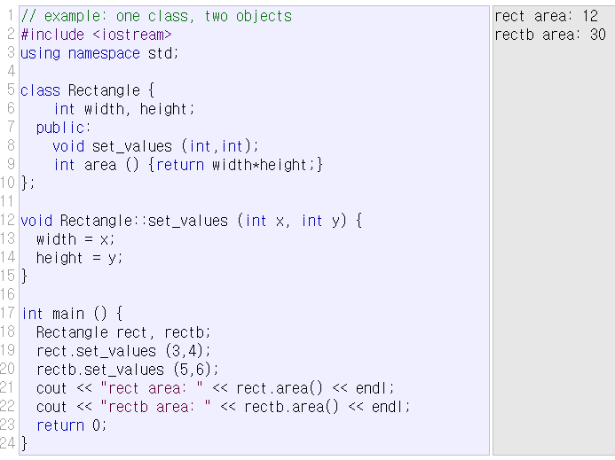
class
class: data structure type that can contain member data and member functions.

Slide 27
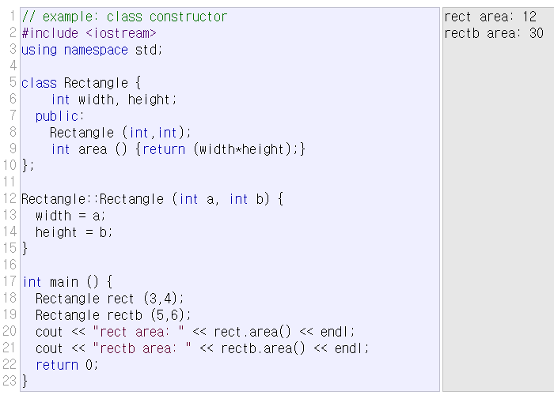
class constructor/destructor
  member function that is automatically called when the object is created/deleted.

Slide 28
pointers to class object
#include <iostream>
using namespace std;
class Rectangle {
private:
int width, height;
public:
Rectangle() { width=1; height=1; }
Rectangle(int x, int y) : width(x), height(y) {}
int area() { return width*height; }
};
int main()
{
Rectangle obj(3,4);
Rectangle *foo, *bar, *baz;
foo = &obj;
bar = new Rectangle(5,6);
baz = new Rectangle[2];
cout << "obj's area: " << obj.area() << '\n';
cout << "*foo's area: " << foo->area() << '\n';
cout << "*bar's area: " << bar->area() << '\n';
cout << "baz[0]'s area: " << baz[0].area() << '\n';
cout << "baz[1]'s area: " << baz[1].area() << '\n';
delete bar;
delete[] baz;
return 0;
}

Slide 29
13. C++ File Processing

Slide 30
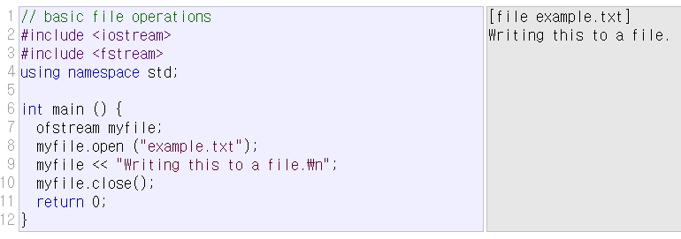
file stream class
  ofstream: stream class to write on files
  ifstream: stream class to read from files
  fstream: stream class to read and write from/to files

Slide 31
File Processing
File Open
  Text? Or Binary?
  In case of writing, append? Or truncate?
  File Position (automatic? Or User-Control?)
File Processing
(Read/Write)
File open
File close

Slide 32
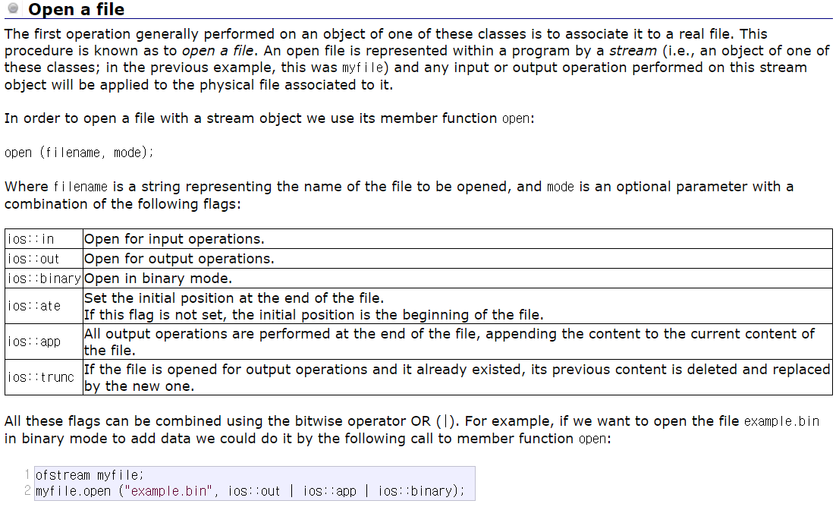
File open mode

Slide 33
File Open/Close
Default mode
Check if file open was OK
Closing a file

Slide 34
Text File (Write)- Example

Slide 35
Text File (Read) - Example

Slide 36
Status Check

Slide 37
Get and Put Stream Positioning
tellg()/tellp()
  Returns current get/put position
seekg()/seekp()
  Change the location of the get/put position
  seekg(position);
  seekp(position);
  seekg(offset, direction);
  seekp(offset, direction);

Slide 38
File Position Example

Slide 39
Binary File Processing

Slide 40
보충 자료 (강의 페이지)
C++ Namespace (cplusplus.com)
  https://cplusplus.com/doc/oldtutorial/namespaces/
static vs. dynamic memory allocation (토론 자료)
예제 소스: src_print, src_string, src_getline, src_getline_fileio, src_string_cstyle, src_array
  src_getline_fileio 입력 파일: example.txt

Slide 41
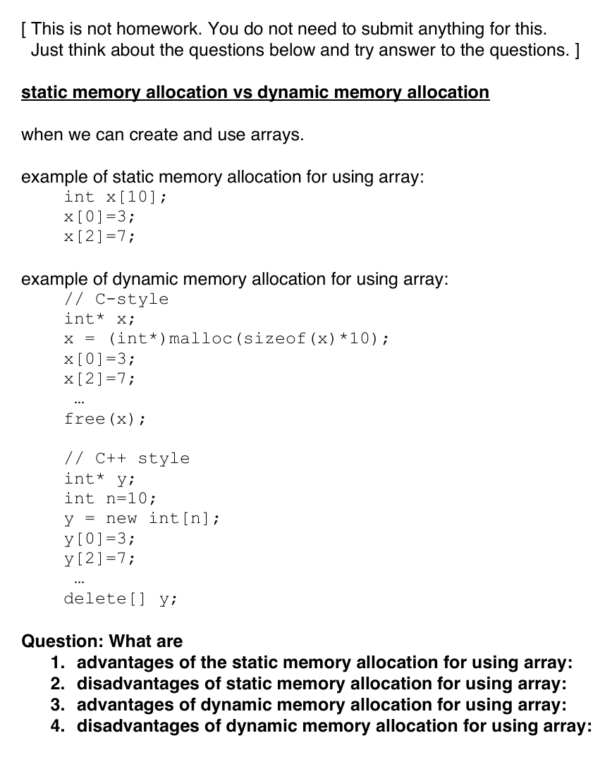
static vs. dynamic memory allocation

Slide 42
src_print.cpp
1 #include <iostream>
2 #include <cstdio>
3 #include <print>
4 #include <format>
5
6 using namespace std;
7
8 int main()
9 {
10 double pi=3.141592;
11 int age = 21;
12 printf("pi=%7.2f , age=%d\n",pi,age);
13 cout << format("pi={:7.2f} , age={}\n",pi,age);
14 print("pi={:7.2f} , age={}\n",pi,age);
15
16 return 0;
17 }

Slide 43
src_string.cpp (1/4)
1 #include <iostream>
2 #include <string>
3 using namespace std;
4
5 int main() {
6 // 1. Creating strings
7 string s1 = "Hello";
8 string s2("World");
9 string s3; // empty string
10
11 // 2. Concatenation
12 s3 = s1 + " " + s2;
13 cout << s3 << endl; // Hello World
14
15 // 3. Length
16 cout << "Length: " << s3.length() << endl;
17 cout << "Size: " << s3.size() << endl; // same as length()
18
19 // 4. Accessing individual characters
20 cout << s3[0] << endl; // H
21 cout << s3.at(1) << endl; // e
22
23 // 5. Modifying a character
24 s3[0] = 'h';
25 cout << s3 << endl; // hello World
26
27 // 6. Adding text

Slide 44
src_string.cpp (2/4)
28 s3 += "!";
29 s3.append(" C++");
30 cout << s3 << endl; // hello World! C++
31
32 // 7. Finding a substring
33 size_t pos = s3.find("World");
34
35 if (pos != string::npos)
36 cout << "Found at index: " << pos << endl;
37
38 // 8. Extracting a substring
39 string sub = s3.substr(6, 5);
40 cout << sub << endl; // World
41
42 // 9. Replacing part of a string
43 s3.replace(6, 5, "C++");
44 cout << s3 << endl; // hello C++! C++
45
46 // 10. Inserting text
47 s3.insert(5, " beautiful");
48 cout << s3 << endl; // hello beautiful C++! C++
49
50 // 11. Erasing part of a string
51 s3.erase(5, 10);
52 cout << s3 << endl; // hello C++! C++
53
54 // 12. String comparison

Slide 45
src_string.cpp (3/4)
55 string a = "apple";
56 string b = "banana";
57
58 if (a < b)
59 cout << "apple comes before banana" << endl;
60
61 if (a == "apple")
62 cout << "a is apple" << endl;
63
64 // 13. Checking whether a string is empty
65 if (s3.empty())
66 cout << "String is empty" << endl;
67
68 // 14. Iterating through characters
69 for (char c : s3)
70 cout << c << ' ';
71 cout << endl;
72
73 // 15. C-style string when needed
74 const char* p = s3.c_str();
75 cout << p << endl;
76
77 // 16. Numeric Conversions
78 string doubleStr = "123.45";
79 string intStr = "67";
80 double dval = stod(doubleStr); // String to double
81 int ival = stoi(intStr); // String to int

Slide 46
src_string.cpp (4/4)
82 string formatted1 = to_string(dval * 2); // Number to string
83 string formatted2 = to_string(ival * 2); // Number to string
84 cout << "conversion result: " << formatted1 << " , " << formatted2 << "\n";
85
86 return 0;
87 }

Slide 47
src_getline.cpp (1/2)
1 #include <iostream>
2 #include <string>
3 #include <sstream>
4 #include <fstream>
5 using namespace std;
6
7 int main()
8 {
9 cout << "[student_id] [name] [department] [age] [GPA(score)]\n";
10
11 string student_id;
12 string name;
13 string dept;
14 int age;
15 double GPA;
16 double GPA_total=0.0;
17 string linestr;
18 int count=0;
19
20
21 while (getline(cin,linestr)) {
22 // ifstream myfile("example.txt");
23 // while (getline(myfile,linestr)) {
24 if (linestr.empty()) break;
25 istringstream iss(linestr); // istringstream treats a string as an input stream.
26 iss >> student_id >> name >> dept >> age >> GPA ;
27 cout << "student_id: " << student_id << "\n";

Slide 48
src_getline.cpp (2/2)
28 cout << "name: " << name << "\n";
29 cout << "department: " << dept << "\n";
30 cout << "age: " << age << "\n";
31 cout << "GPA(score): " << GPA << "\n";
32 GPA_total += GPA;
33 count++;
34 }
35 // myfile.close();
36 cout << "GPA average: " << GPA_total/count << "\n";
37
38 return 0;
39 }

Slide 49
src_getline_fileio.cpp (1/2)
1 #include <iostream>
2 #include <string>
3 #include <sstream>
4 #include <fstream>
5 using namespace std;
6
7 int main()
8 {
9 cout << "[student_id] [name] [department] [age] [GPA(score)]\n";
10
11 string student_id;
12 string name;
13 string dept;
14 int age;
15 double GPA;
16 double GPA_total=0.0;
17 string linestr;
18 string temp_str;
19 int count=0;
20
21
22 // while (getline(cin,linestr)) {
23 ifstream myfile("example.txt");
24 ofstream out("example_out.txt");
25 while (getline(myfile,linestr)) {
26 if (linestr.empty()) break;
27

Slide 50
src_getline_fileio.cpp (2/2)
28 student_id=linestr.substr(0,8);
29 name=linestr.substr(10,10);
30 dept=linestr.substr(20,10);
31 age=stoi(linestr.substr(30,3));
32 GPA=stod(linestr.substr(40,4));
33
34 cout << "student_id: " << student_id << "\n";
35 cout << "name: " << name << "\n";
36 cout << "department: " << dept << "\n";
37 cout << "age: " << age << "\n";
38 cout << "GPA(score): " << GPA << "\n";
39 GPA_total += GPA;
40 count++;
41 temp_str=format("{:10s}{:20s}{:20s}{:10d}{:10.2f}\n",student_id,name,dept,age,GPA);
42 cout << temp_str;
43 out << temp_str;
44 }
45 myfile.close();
46 out.close();
47 cout << "GPA average: " << GPA_total/count << "\n";
48
49 return 0;
50 }

Slide 51
example.txt (src_getline_fileio 입력)
1 20221523 Lisa_Kim Comp_Sci 21 4.12
2 20242123 Homer_Lee Elec_Eng 22 3.51
3 20231118 Bart_Park Mech_Eng 23 3.81

Slide 52
src_string_cstyle.c (1/4)
1 #include <stdio.h>
2 #include <string.h>
3 #include <stdlib.h>
4
5 int main(void) {
6 // 1. Creating strings
7 char s1[100] = "Hello";
8 char s2[100] = "World";
9 char s3[200] = ""; // empty string
10
11 // 2. Concatenation
12 strcpy(s3, s1);
13 strcat(s3, " ");
14 strcat(s3, s2);
15 printf("%s\n", s3); // Hello World
16
17 // 3. Length
18 printf("Length: %zu\n", strlen(s3));
19
20 // 4. Accessing individual characters
21 printf("%c\n", s3[0]); // H
22 printf("%c\n", s3[1]); // e
23
24 // 5. Modifying a character
25 s3[0] = 'h';
26 printf("%s\n", s3); // hello World
27

Slide 53
src_string_cstyle.c (2/4)
28 // 6. Adding text
29 strcat(s3, "!");
30 strcat(s3, " C");
31 printf("%s\n", s3); // hello World! C
32
33 // 7. Finding a substring
34 char *pos = strstr(s3, "World");
35
36 if (pos != NULL)
37 printf("Found at index: %td\n", pos - s3);
38
39 // 8. Extracting a substring
40 char sub[6];
41 strncpy(sub, s3 + 6, 5);
42 sub[5] = '\0';
43 printf("%s\n", sub); // World
44
45 // 9. Replacing part of a string
46 // replacement is not supported in C
47
48 // 10. Inserting text
49 // insertion is not supported in C
50
51 // 11. Erasing part of a string
52 // erase 6 characters starting at index 5
53 // erase is not supported
54

Slide 54
src_string_cstyle.c (3/4)
55 // 12. String comparison
56 char a[] = "apple";
57 char b[] = "banana";
58
59 if (strcmp(a, b) < 0)
60 printf("apple comes before banana\n");
61
62 if (strcmp(a, "apple") == 0)
63 printf("a is apple\n");
64
65 // 13. Checking whether a string is empty
66 if (strlen(s3) == 0)
67 printf("String is empty\n");
68
69 // 14. Iterating through characters
70 for (size_t i = 0; i < strlen(s3); i++)
71 printf("%c ", s3[i]);
72
73 printf("\n");
74
75 // 15. C-style string
76 const char *p = s3;
77 printf("%s\n", p);
78
79 // 16. Numeric conversions
80 char doubleStr[] = "123.45";
81 char intStr[] = "67";

Slide 55
src_string_cstyle.c (4/4)
82
83 double dval = atof(doubleStr); // String to double
84 int ival = (int)atoi(intStr); // String to int
85
86 char formatted1[50];
87 char formatted2[50];
88
89 sprintf(formatted1, "%f", dval * 2);
90 sprintf(formatted2, "%d", ival * 2);
91
92 printf("conversion result: %s , %s\n",
93 formatted1, formatted2);
94
95 return 0;
96 }

Slide 56
src_array.cpp (1/2)
1 #include <iostream>
2 using namespace std;
3
4 int main() {
5 // 1. Standard Array
6 int stackArray[3] = {10, 20, 30};
7
8 // 2. Dynamic Memory Allocation
9 int size;
10 cout << "input size: ";
11 cin >> size;
12 int* heapArray = new int[size];
13
14 // 3. Pointer Operations
15 int* ptrToStack = stackArray;
16
17 // Populate the heap array using pointer offset notation
18 cout << "enter " << size << " integers: \n";
19 for (int i = 0; i < size; ++i) {
20 cin >> heapArray[i];
21 }
22
23 // 4. Output Comparisons
24 for (int i = 0; i < 3; ++i) {
25 cout << "stackArray[" << i << "]=" << stackArray[i]
26 << " | *(ptrToStack+" << i << ")=" << *(ptrToStack + i) << "\n";
27 }

Slide 57
src_array.cpp (2/2)
28
29 for (int i = 0; i < size; ++i) {
30 cout << "*(heapArray+" << i << ")= " << *(heapArray + i)
31 << " | heapArray[" << i << "]=" << heapArray[i] << "\n";
32 }
33
34 // 5. Memory Cleanup
35 // Only heap-allocated memory requires manual deletion.
36 delete[] heapArray;
37
38 return 0;
39 }

